Slide 1
State of Texas Debt – An Overview
January 26, 2023
Texas Bond Review Board Texas Public Finance Authority
Rob Latsha, Executive Director Lee Deviney, Executive Director
rob.latsha@brb.texas.gov lee.deviney@tpfa.texas.gov
512-463-1741 512-463-5544
www.brb.texas.gov www.tpfa.texas.gov

Slide 2
1. Debt Instruments

Slide 3
What is a Debt Instrument?
A debt instrument is a contract for a loan between a lender and a borrower specifying:
  Term or maturity for debt security is the due date for the loan (e.g., years, months, days)
  Interest rate on the bond (e.g., 5%);
  Debt service or repayment schedule,
  (e.g., monthly, semi-annually or annually);
  Revenue source pledged to repay the loan

Slide 4
Why issue Governmental Debt?
Debt Issuance is a discretionary financing tool
Conserve current revenue
Match capital project costs to useful life of the asset
Manage cash flow

Slide 5
Common Terms
Par – Face value of a security
  Discount or Premium – Amount the price of a security is less than or exceeds par value
Coupon – Interest rate paid on a security
  Fixed rate – Interest rate that does not fluctuate during the life of the security
  Variable rate – Interest rate that resets at fixed intervals based on a predetermined index or formula
Yield – Investor rate of return
Debt Service – the repayment of the borrowed funds that consist of both principal (amount borrowed) and/or interest

Slide 6
Types of Debt Instruments
Commercial Paper
Up to 270 days and interest rate resets at maturity if not redeemed.
Notes
Up to 5 years. Fixed or Variable Rate
Bonds
5 – 30 years or more. Fixed or variable interest rate.

Slide 7
2. Texas Public Finance Authority

Slide 8
Texas Public Finance Authority
Issuing Agency – TGC Ch. 1232
Board: Appointed by the Governor
Issues state debt as authorized by the legislature
Issues for 19 state agencies including 2 universities
Administers the Master Lease Purchase Program

Slide 9
TPFA Client Agencies
Cancer Prevention and Research Institute of Texas
Texas Agriculture Finance Authority
Texas Commission on Environmental Quality
(formerly Texas Low-Level Radioactive Waste Disposal Authority)
Texas Department of Agriculture
Texas Department of Criminal Justice
Texas Department of Public Safety
Texas Department of Transportation
(Governor’s Office – Colonia Roadway Grant Program)
Texas Facilities Commission
Texas Health and Human Services Commission
Texas Historical Commission
Texas Juvenile Justice Department
Midwestern State University*
Texas Military Department
(formerly Office of Adjutant General, and Texas Military Facilities Commission)
Texas Military Preparedness Commission
(Texas Military Value Revolving Loan Fund)
Texas Parks and Wildlife Department
Texas School for the Blind and Visually Impaired
Texas School for the Deaf
Texas Southern University
Texas State Preservation Board
Texas Windstorm Insurance Association
Texas Workforce Commission
Optional Use of TPFA as an Issuer
Stephen F. Austin State University
Texas State Technical College System
General Academic Teaching Institutions as defined by Section 61.003 of the Texas Education Code
*The 87th Legislature transferred Midwestern State University to the Texas Tech University System.

Slide 10
TPFA Issuance History
Manage
  Managing $3.768 billion of bonds as of 12/31/2022
Issued
  $25.45 billion issued to date
Savings
  Provided savings of over $302 million to general revenue supported debt
Notes:
Discuss amounts/types of debt/current outstanding/other data points. Examples from LAR, % allocation of issued debt

Slide 11
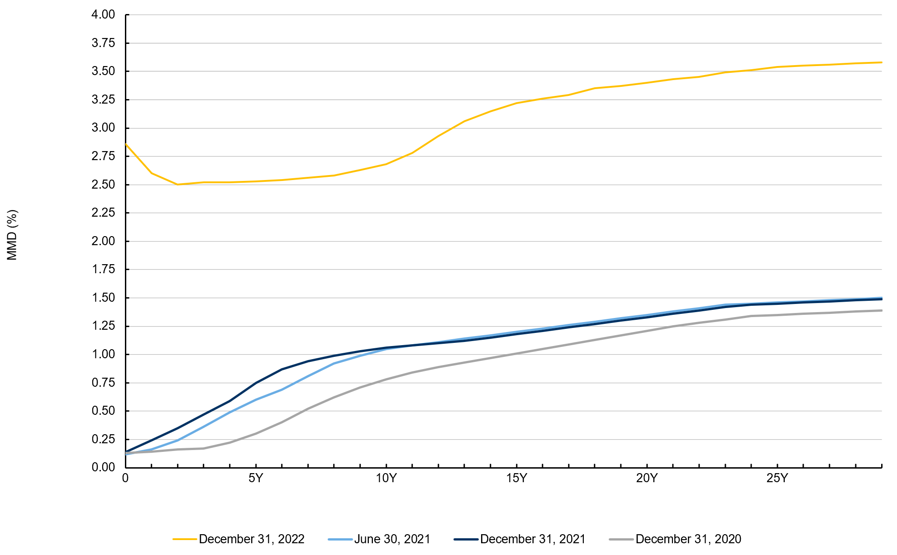
AAA MMD Historical Yield Comparison
Source: Thomson Reuters Municipal Market Data

Slide 12
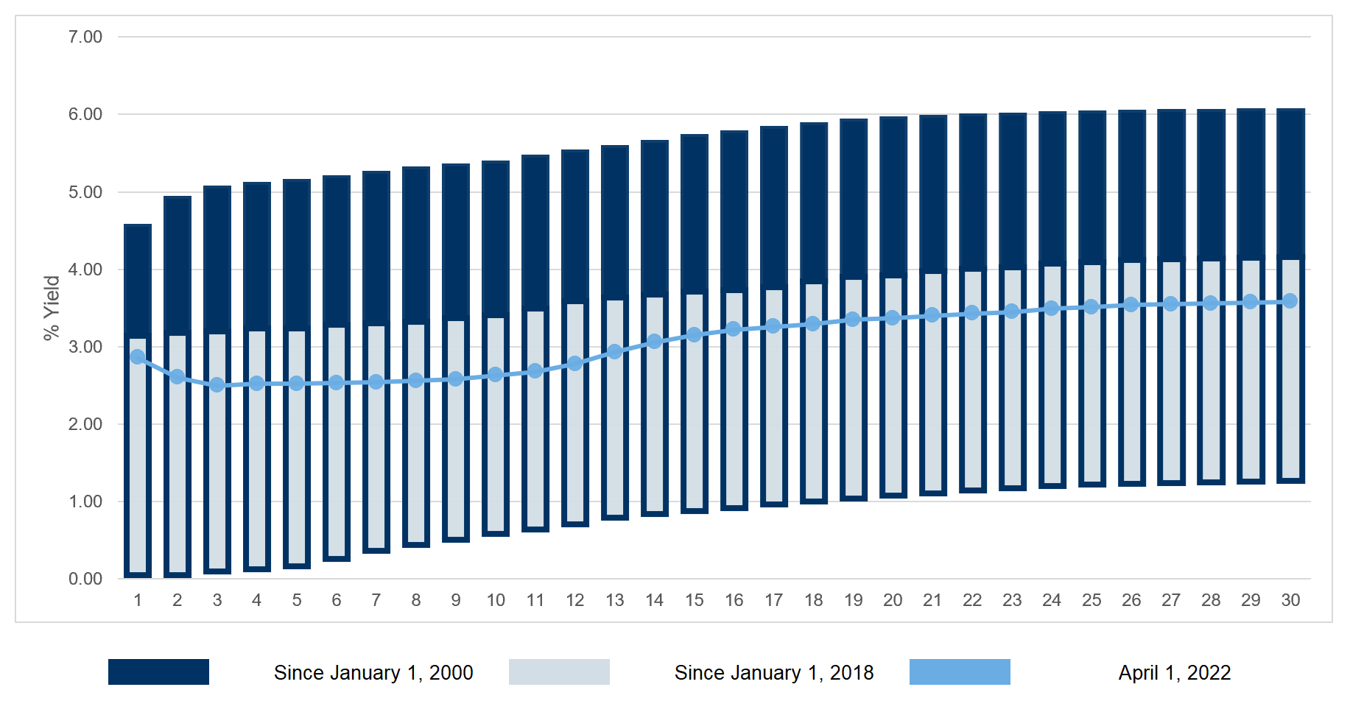
Maximum and Minimum AAA MMD Yields

Slide 13
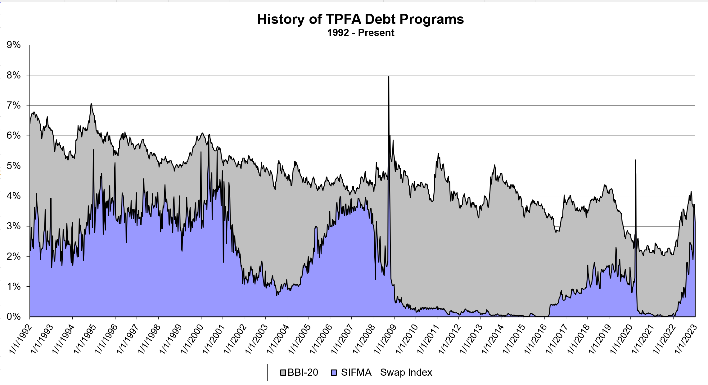
Long Term vs. Short Term Rates

Slide 14
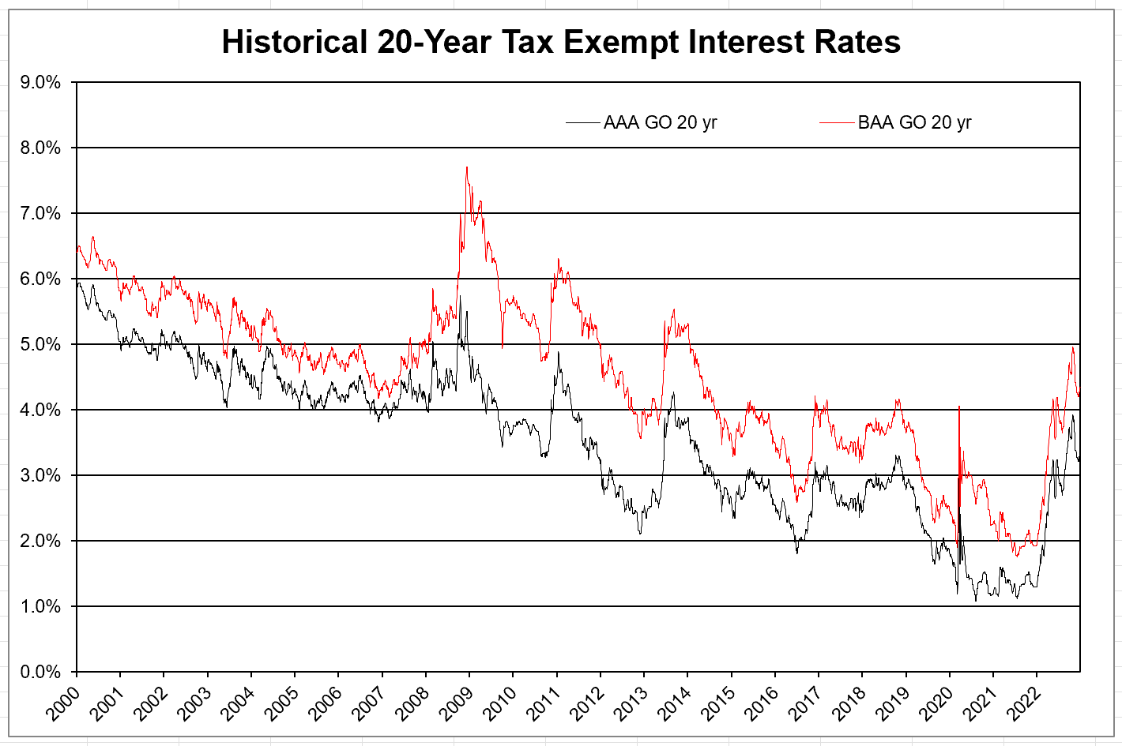
Credit Ratings Effect On Interest Rates

Slide 15
Taxation on Interest Earnings
Taxable
  Earnings are taxed at federal and state/local levels
  Exempt from private use restrictions
  Examples include corporate bonds, sports facility, Cancer Prevention and Research Institute of Texas projects grants
Tax-Exempt
  Earnings exempt from taxation which allows for investors to accept a lower coupon
  Subject to federal tax law limitations on investment and use of proceeds
  Examples include roads, schools, government buildings

Slide 16
Taxable vs. Tax-Exempt Debt
State of Texas issues tax-exempt debt except when purpose of issue is not tax-exempt eligible
  Examples:
    Tax-Exempt: Roads, Schools, Airports, Infrastructure Projects;
    i.e. a Project which benefits the Public.
    Taxable: Corporate Bonds, Financing Local Sports Facility; i.e. Projects or Activities which do not have a qualifying benefit to the Public.

Slide 17
3. Types of Texas Debt

Slide 18
General Obligation (GO) Debt
Constitutional Pledge:
    Legally secured by a constitutional pledge of the first monies coming into the State Treasury that are not constitutionally dedicated for another purpose
Approval needed per Tx. Const. Art III Sec. 49:
    2/3 vote of both houses of the legislature and
    Majority of Texas Voters
Examples: Mental health facilities (HHSC), Prisons (TDCJ), Parks (TPWD), Cancer Prevention and Research Institute of Texas (CPRIT), Transportation (TxDOT)

Slide 19
Revenue Debt
Secured by a specific revenue source
Does not require voter approval
Examples: College and University debt,
Certain water development bonds

Slide 20
Lease Purchase
TPFA issues revenue debt to finance a purchase of personal property or equipment under its Master Lease Purchase Program (MLPP)
TPFA holds the title to the property and leases the property to the client agency
Client agency makes lease payments to TPFA from appropriations to the client agency
TPFA uses the lease payments to pay debt service

Slide 21
Tax & Revenue Anticipation Notes (TRAN)
Issued by the Comptroller to address the State’s cash flow needs (i.e. mismatch between state revenues and expenditures)
Must be repaid before the end of the biennium; usually issued and repaid each fiscal year
Repaid from General Revenue

Slide 22
Refundings
Used to:
  Refinance – Issue new debt to pay off old debt
  Lower interest rates
  Change bond covenants
  Change repayment schedule (“Restructure”)
Can be a current refunding or an advance refunding
  Federal tax law no longer permits tax-exempt bonds to be advance refunded unless refunded using taxable debt

Slide 23
4. Debt Sale Mechanics

Slide 24
State Debt Issuance Process
Legislative authorization and appropriation
Issuer Board approval
Bond Review Board approval
Bond Sale (Negotiated/Competitive/Privately Placed)
Attorney General approval
Closing
Ongoing Administration/Reporting

Slide 25
Legislative Authorization
The Legislature must authorize the specific project for which bonds are to be issued.
Approvals
Specific project in statute or appropriations bill
Appropriations
To use bond proceeds
Amounts sufficient to pay debt service
Use of bond proceeds

Slide 26
Finance Team
Bonds and Notes:
  Financial Advisor
  Bond Counsel
  Underwriter(s)
  Rating Agencies
Commercial Paper Transactions also include:
    Dealer
    Paying Agent
    Liquidity Provider

Slide 27
Methods of Sale
Negotiated (most common) | Issuance has unusual financial or legal structure Issuance timing important (e.g., refunding) Bond sale requires more pre-marketing effort
Competitive | Straightforward structure Well-known credit and security pledge Size and ratings often attract bidders
Private Placement | Unique financial or legal structure Sold directly to purchaser Not underwritten

Slide 28
Debt Administration
Timely debt service payments
Monitor expenditure of bond proceeds
Comply with federal tax law
  use of facility
  investment of bond proceeds
  arbitrage rebate compliance
Legislative appropriations for debt service, if required
Continuing Disclosure

Slide 29
Issuance Process Life Cycle
Planning
Funding
Ongoing
Agency Identifies Project(s)
Request for Financing
Agency executes projects
Prepare Cost and Timeline Estimates
Determine Financing Method and Prepare Documents
Monthly Status Report
(until proceeds fully spent)
Request Bond Proceeds and Debt Service
Issue Debt and transfer Proceeds to agency
Pay Debt Service

Slide 30
Ongoing Responsibilities
Agency
TPFA
Executes Project
Monthly Status Report
Pay debt service
Monitor for IRS compliance
Update agency on debt service requirements
May need to request debt service
Request UB authority for unspent proceeds for next biennium (see next slide)
Monitor and request debt service appropriations

Slide 31
Client Agency Biennial Request
If all of the authorization has not been issued or the agency has not encumbered all bond proceeds prior to the end of the biennium, ensure the ability to issue and expend those proceeds for the project in a subsequent biennium is continued; usually done by “U.B.” rider in agency’s bill pattern.
If the full amount authorized has not been approved by TPFA and BRB prior to the end of the biennium, agency will need to ensure the authorization is continued; [usually in the agency’s bill pattern]
For certain projects, debt service that is appropriated to the agency will need to be requested by the agency in their LAR. (TPFA will provide an estimate before the LAR process and update as needed).

Slide 32
Key Takeaways
Financing is a tool to maximize budget
Planning is key – start early
Communicate with TPFA throughout the process

Slide 33
5. General Revenue Impact
Self-Supporting and Not Self-Supporting

Slide 34
Self-Supporting
Repaid with revenues other than general revenues, can be either GO or revenue debt
Examples:
  GO: Water Development Board debt repaid from loans for water and wastewater projects, Mobility Fund Transportation Bonds
  Revenue: University revenue financing system debt, Texas Dept. of Housing and Community Affairs single family mortgage debt

Slide 35
Not Self-Supporting
Repaid with state general revenues, can be either GO or revenue debt
Examples:
  GO: Higher Education Fund debt, most TPFA debt, CPRIT debt, Prop 12 HIGO transportation debt
  Revenue: TPFA MLPP, Building Revenue Bonds

Slide 36
6. State Debt

Slide 37
Bond Review Board
Oversight Agency – TGC Ch. 1231
Board: Governor, Lt. Governor, Comptroller and Speaker (non-voting)
Approves state debt and lease purchases that are more than $250,000 or have a term longer than 5 years (excludes university revenue debt rated AA- or higher, TRAN, SHF revenue anticipation notes, and Permanent University Fund debt)
Collects, analyzes and reports information on state and local debt
Administers the state's Private Activity Bond Allocation Program
Administers Other Federal Bonding Programs

Slide 38
Texas Debt Issuers
Agencies | Higher Education Institutions
Texas Department of Transportation
  Private Activity Bond Surface Transportation Corp.
  Grand Parkway Transportation Corp.
Texas Public Finance Authority
  TPFA Charter School Finance Corp.
  Natural Gas Securitization Finance Corp.
Texas Department of Housing & Community Affairs
Texas Veterans Land Board
Texas Higher Education Coordinating Board
Texas State Affordable Housing Corp.
Texas Water Development Board
Office of Economic Development & Tourism
Texas Agriculture Finance Authority
Debt issued by TPFA - $530 million authorized but unissued
The University of Texas System
The Texas A&M University System
University of Houston System
Texas State University System
Texas Tech University System (Midwestern State University now part of TTUS)
University of North Texas
Texas Southern University
Stephen F. Austin State University
Texas Woman’s University
Texas State Technical College System

Slide 39
State Debt Outstanding
Texas Debt Outstanding as of August 31, 2022 (millions)
 | Self-Supporting | Not Self-Supporting | Total
General Obligation | $11,102 | $6,186 | $17,288
Revenue | $37,018 | $734 | $37,752
Conduit/Component* | $9,363 | $0 | $9,363
Total | $57,483 | $6,920 | $64,403
*Not a legal liability of the state, secured by third party entities

Slide 40
State Debt Outstanding
As of 8/31/22 ($ in billions)

Slide 41
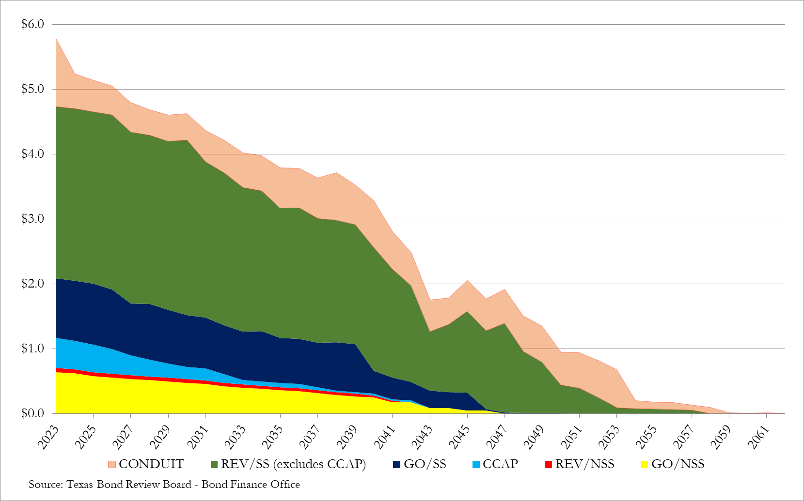
Debt Service on State Debt
As of 8/31/22 ($ in billions)

Slide 42
Debt Issued by Universities
Revenue Debt: Revenue financing system (RFS) debt finances permanent improvements and is repaid from system-wide revenue (except legislative appropriations)
Capital Construction Assistance Projects (CCAP) (TEC Ch. 55): Legislature may authorize this type of debt and appropriate general revenue to offset the institution’s debt service
PUF (Tx Const. Art. VII Ch. 18): Certain institutions within The University of Texas and Texas A&M Systems may issue obligations backed by income from the Permanent University Fund (PUF)
HEF (Tx Const. Art. VII Ch. 17): Certain institutions, including some within The University of Texas and Texas A&M Systems, may issue Higher Education Fund debt (HEF or Constitutional Appropriation Bonds)

Slide 43
College & University Debt Outstanding
As of 8/31/2022 ($ in billions)

Slide 44
Constitutional Debt Limit
Tx. Const. Art. III Sec. 49-j
Texas Constitution prohibits the issuance of additional state debt if the percentage of debt service payable by general revenue in any fiscal year exceeds 5% of the average of unrestricted general revenue for the past three years
CDL at 2022 FYE: 1.11% for issued debt
2.25% issued and authorized but unissued debt

Slide 45
Constitutional Debt Limit

Slide 46
7. Credit Ratings

Slide 47
Texas Credit Ratings
State Credit Ratings:
  Moody’s Aaa
  Standard and Poor’s AAA
  Fitch AAA
  Kroll AAA
Factors Considered:
  Economy
  Financial condition
  Debt burden
  General management practices

Slide 48
SELECTED DEBT MEASURES FOR TEXAS AND OTHER STATES RATED AAA

Slide 49
General Obligation Credit Ratings -
10 Most Populous States

Slide 50
State of Texas
Positive Rating Drivers
Strong Financial Management
Low State Debt (not self-supporting)
Growth-Oriented Economy
Significant Reserve Balances

Slide 51
State of Texas
Negative Rating Drivers
Growth Related Spending Pressures
  School Funding, Transportation, Water
Unfunded Pension Liabilities
Sales Tax Dependence
Assistance Programs such as Medicaid

Slide 52
8. Local Debt

Slide 53
Total Debt Outstanding as of 8/31/22 ($ in billions)

Slide 54
State and Local Debt – 10 Most Populous States (most recent data available)

Slide 55
Types of Local Governments
School Districts
Cities
Counties
Community/Junior College Districts
Water Districts & Authorities
Health/Hospital Districts & Authorities
Other Special Districts (road districts, tollway authorities, housing authorities, sports authorities)

Slide 56
Local Debt Outstanding
($284.15* billion outstanding as of 8/31/2022)
*Excludes Conduit Debt

Slide 57
Local Debt Outstanding by Fiscal Year
($ in billions)

Slide 58
Local Debt Issuance Process
Voter and/or Governing Body approval*
Sale (Negotiated/Competitive/Privately Placed)
Attorney General approval
Closing
Issuance data is sent to Bond Review Board for analysis
Ongoing Administration/Reporting
* The BRB does not approve local debt issuances

Slide 59
Types of Local Government Long-Term Debt
General Obligation Debt (66%)
Supported by ad valorem (property) taxes
Includes combination tax & revenue debt
Usually voter approved
Revenue Debt (34%)*
Voter approval not needed
Secured by a specific revenue source
*Excludes Conduit Debt

Slide 60
Not Voter Approved: Certificates of Obligation - LGC Ch. 271
Issued without voter approval
Used for the construction of public works
GO debt payable from ad valorem taxes
Issuers: cities, counties and some hospital districts
Maturity up to 40 years
Petition by 5% of the voters requires a voter referendum
HB 1378 (84th Leg) and HB 477 (86th Leg) amends LGC Ch. 271.

Slide 61
Certificate of Obligation Debt Issuance
($ in billions)

Slide 62
Certificate of Obligation Debt Outstanding
($ in billions)

Slide 63
Not Voter Approved: Tax Notes and Other Bonds
Tax Notes – TGC Ch. 1431
No opportunity for voter petition
Maturity up to 7 years
Used for the construction of public works
Other types of bonding authority:
Time Warrants – TEC Ch. 45.103
  Issued mainly by school districts

Slide 64
Repayment Structures
Current Interest Bonds - CIBs
Most commonly used debt structure
Interest paid on a periodic basis
Capital Appreciation Bonds - CABs
Sold at a discount
No current interest payment
At maturity investor receives both principal and interest
Interest compounds on interest
Largely utilized by ISDs to preserve debt capacity

Slide 65
Characteristics of CABs
CABs are issued to:
    Preserve debt limits – reduced par
    Help local governments reach tax-rate targets
    Become more expensive as maturity lengthens due to compounding
  Premium CABs (PCABs) are CABs sold with a premium
      raise additional proceeds and still preserve par limits
      local governments issue more PCABs than non-premium CABs
HB 114 (84th Legislature) and SB 295 (85th Legislature)
amends TGC Ch. 1201.0245

Slide 66
Local Government CABs Issued 2008-2022
($ in billions)

Slide 67
Local Debt Service Outstanding
Fiscal Years 2008–2022 ($ in billions)

Slide 68
CAB Maturity Amount Outstanding
Fiscal Years 2008–2022 ($ in billions)

Slide 69
9. Private Activity Bond (PAB) Allocation Program

Slide 70
PAB Summary
Title 26 Internal Revenue Code, TGC Ch. 1372
Private Debt sold like a public security (tax-exempt)
Allowable common uses include:
  low-income mortgages,
  small industry,
  low-income housing,
  student loans,
  waste disposal facilities, etc.

Slide 71
Effects of SB 1474 (86th Session)
Section 4 reallocated the authority among issuers/sub-ceilings
Section 13 raised and indexed the project limits
Section 14 extended the time to close

Slide 72
PAB Individual Project Limits 1372.037 prior to August 15th collapse
SC 1- $50 million or $1.70% of state ceiling except TDHCA (33.34% of SC 1 amount) and
TSAHC (10% of SC 1 amount)
SC 2- $100 million or 3.40% of state ceiling except THECB ($200 million or 6.80% of state ceiling)
SC 3- $10 million; limited by Federal Law
SC 4- $50 million or 1.70% of state ceiling
SC 5- $100 million or 3.40% of state ceiling

Slide 73
More applications earlier
*2023 anticipated PAB Reservations through January

Slide 74
Private Activity Bond Program for 2022 (TGC 1372.022)

Slide 75
Questions?

